Slide 1

Sprint 2 Case Study on- Tweet App
Presented By- Group 7(Batch - 3)

Slide 2
Contents
Objective
Technologies Used
Block Diagram of work flow
Backend
-SQL Server Management Studio
-Visual Studio 2019
-Microsoft AZURE
Frontend- Visual Studio Code
-(HTML and CSS)

Slide 3
Objective
Tweet App is a Single Page App for registered users to post new tweets, reply to tweets, like/unlike tweets.
The aim of the Tweet App is as follows-
User can registration and login
Post new Tweet
Get all Tweets
Like tweet
Follow users
Get all Users

Slide 4
Technologies Used
Visual Studio Code
SQL Server Management Studio
Visual Studio 2019
Microsoft Azure

Slide 5
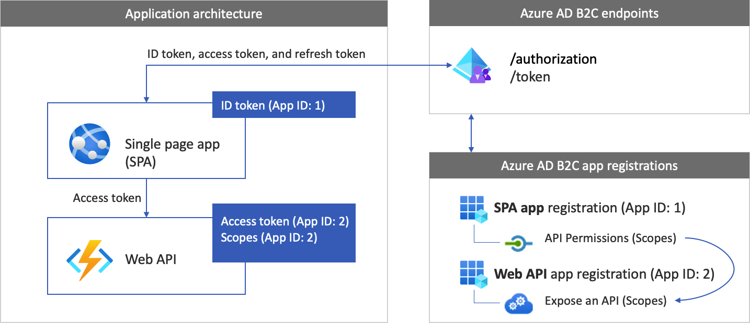
Block Diagram of Work Flow

Slide 6
Backend
SQL Server Management Studio
SSMS provides tools to configure, manage and administer instances of Microsoft SQL Server, and it brings together a range of graphical and visual design tools and rich script editors to simplify working with SQL Server.
TWEET TABLE LOGIN TABLE
Columns | Data Type
Id | int
AuthorName | nvarchar(100)
AuthorLogo | nvarchar(100)
AuthorSlug | nvarchar(100)
TweetTime | nvarchar(100)
TweetDescription | nvarchar(100)
TweetImage | nvarchar(100)
Column | Data Type
Id | Int
FirstName | nvarchar(100)
LastName | nvarchar(100)
Email | nvarchar(100)
LoginId | nvarchar(100)
Password | nvarchar(100)
ConfirmPassword | nvarchar(100)
ContactNumber | Decimal(10.0)

Slide 7
Visual Studio 2019

Slide 8
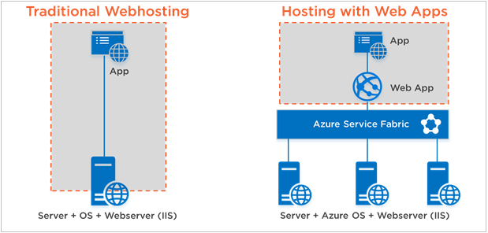
Microsoft azure
Microsoft Azure, formerly known as Windows Azure, is Microsoft's public cloud computing platform. It provides a range of cloud services, including compute, analytics, storage and networking.
Azure offers a large collection of services, which includes platform as a service (PaaS), infrastructure as a service (IaaS), and managed database service capabilities.

Slide 9
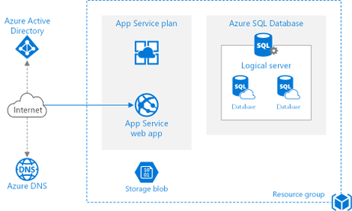
Services used in azure

Slide 10
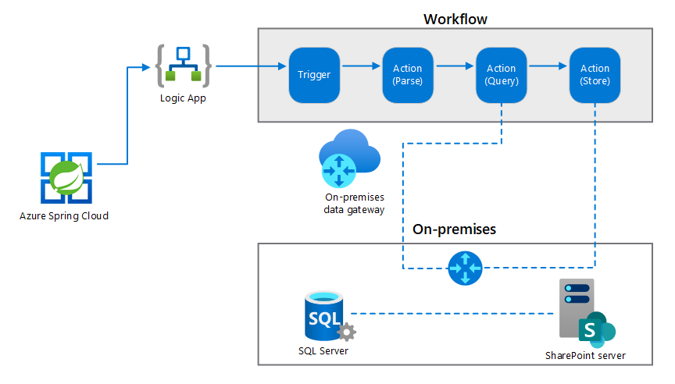
Logic App- Work Flow Diagram

Slide 11

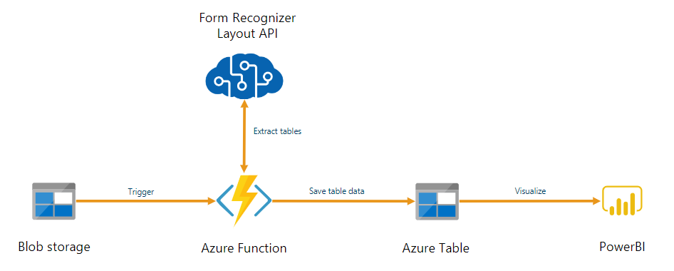
Azure Function

Slide 12
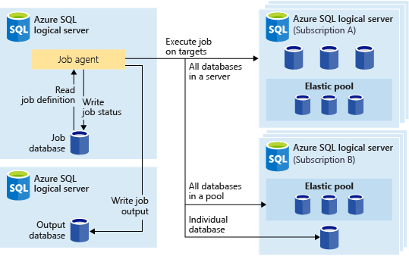
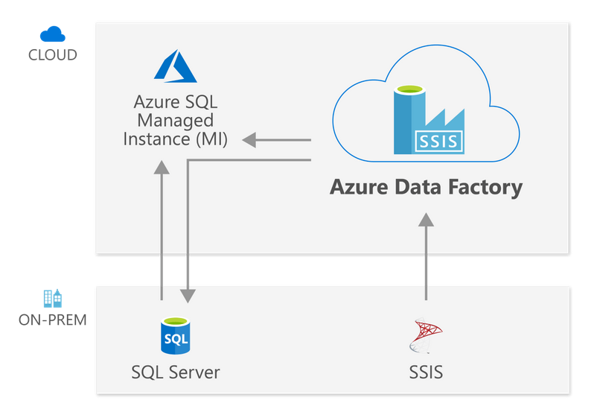
Azure SQL Server

Slide 13

Frontend- Angular

Slide 14
Tweet App WireFrame

Slide 15
THANK YOU

